Slide 1


COBSS and General Scholarship & Bursary Information
Nov 29, 2022

Slide 2

We are grateful
to live, learn, and work
on the Unceded,
Traditional Territory of
The Syilx, Okanagan People.

Slide 3

Grade 12 Grad Info
Text @okm23 to (438) 793-2670

Slide 4

OKMCOUNSELLING.WEEBLY.COM

Slide 5
The Costs of Education
TUITION
STUDENT FEES
HEALTH FEES
DENTAL FEES
BOOKS & SUPPLIES
HOUSING
FOOD
TRANSPORTATION
Start to create a financial plan! Start the conversation!

Slide 6
Early Fee Payments
Plan for fee payments BEFORE next September!
APPLICATION FEES: $30 to upwards of $100+ due when application is submitted
REGISTRATION DEPOSITS: approx. $250 (or more) for confirming your seat due when student accepts admission offer
HOUSING APPLICATION FEES & DEPOSITS: $50 to upwards of $500 various due dates, but before next June
… and that’s all before you even go to a class or graduate high school!

Slide 7
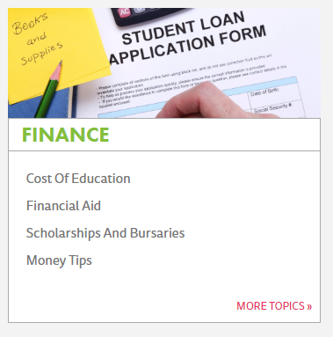

Searching for Funding
Go to: educationplannerbc.ca
Scroll down to FINANCE section.

Slide 8








Tips for a Successful Scholarship Application
Do your research
Read the Criteria
Make a Calendar of Deadlines
Gather references letters (*verify if needed)
Create a scholarship portfolio- reuse/recycle
Gather an updated transcript
Proof read your applications

Slide 9
Sources of Funding
1. BC Ministry of Education Scholarships
    BC Achievement Scholarships - $1,250
    BC Excellence Scholarships - $5,000
    Pathway to Education Scholarships - $5,000
    District / Authority Scholarships - $1,250
2. COBSS
  One Application, 500+ awards
3. Institution Specific Funding
  Institution specific that may be automatically awarded to students based on PSI application or require a separate, specific application

Slide 10
Sources of Funding
4. Community Opportunities
5. Student Loans
6. Student Lines of Credit
  See your banking institution
7. Talk to your Parents and Relatives
  Regarding affiliations with work and organizations that may offer bursaries and scholarships

Slide 11

Institution Specific Funding
Go to the school’s website & look for links such as:
Financial Aid / Assistance
Scholarships
Entrance Awards
Financial Aid & Awards (Okanagan College)
https://www.okanagan.bc.ca/Student_Services/students/financialaid.html (OKANAGAN COLLEGE)
https://you.ubc.ca/financial-planning/scholarships-awards-canadian-students/! ((UBC – OKANAGAN CAMPUS)

Slide 12

Okanagan College Awards
Online Applications
President’s Entrance Award - $5000 (8 Awards)
Canadian citizen or Permanent Resident
Entering eligible program at any campus of OC with offer of admission prior to allocation
Demonstrate leadership and made a contribution to school and community through sports, culture, voluntary service, other extra-curricular activities, &/or scholastic achievement
1 reference from school is required, additional references may be beneficial (use a “Brag Sheet” to assist your reference writers)
Community Spirit Award - $1000 (40 Awards)
Canadian Citizen or Permanent Resident
have a minimum GPA of 65% based on all grade 11 and 12 courses
demonstrate service to school and/or community
Board of Governors Award - $1000 (3+ Awards)
Canadian Citizen or Permanent Resident
demonstrate academic achievement and financial need
  APPLY ONLINE – DEADLINE: MARCH 10TH, 2023
  https://www.okanagan.bc.ca/financial-aid-and-awards#awards

Slide 13

Central Okanagan Foundation
Volunteer Spirit Award: https://www.centralokanaganfoundation.org/grants/scholarship/
a current resident of the Central Okanagan region who is, or has recently been, an active volunteer either in a Canadian community or internationally
One scholarship will be awarded to a resident from each of the four Central Okanagan Municipalities: Peachland, West Kelowna, Kelowna, and Lake Country.
$1,500 for each municipality. DUE: March 17, 2023
KSER Scholarship: https://www.centralokanaganfoundation.org/grants/kser-scholarship/
Grade 12 student-athletes from School District 23 pursuing excellence in athletics and academics.
$2,500 scholarships available plus a bonus scholarship of $2,500 on behalf of Raymond James.
DUE: April 14, 2023
Evan Guthrie Scholarship: https://www.centralokanaganfoundation.org/grants/evan-guthrie-scholarship/
Grade 12 student-athletes to recognize an athlete’s journey through sport and education
two $500 scholarships available. DUE: April 14, 2023

Slide 14

STUDENT LOANS
  www.studentaidbc.ca
  Both BC and Canada provide student loans, integrated in BC as a single loan to streamline the service delivery. Students sign a joint federal-provincial loan agreement and have a single point of contact for managing their loans. At the point of loan repayment, students make just one monthly payment towards their integrated loan balance.
  These loans are based on financial need and are interest-free while you are enrolled in full-time study.
  One application to StudentAidBC covers both the BC and Canada student loan programs.
  StudentAidBC helps with the cost of post-secondary education through student loans, grants, scholarships and other non-repayable financial supports. They also have programs that help with loan repayment. Use this site to determine your eligibility and information on how to apply.
  APPLICATIONS AVAILABLE IN JUNE 2023

Slide 15
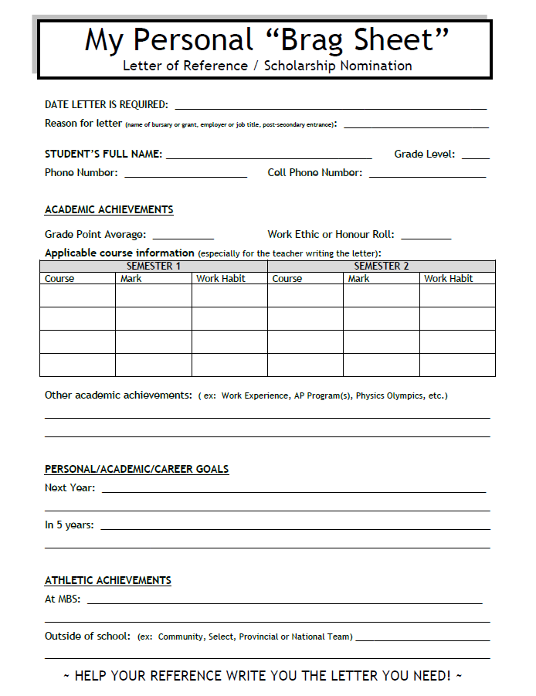
PERSONAL BRAG SHEET
HELP YOUR REFERENCE WRITE YOU THE LETTER YOU NEED!
Indicate the reason for the letter (name of award, scholarship, employer, etc.)
Provide as much detail as you can
Make a copy to give to the person you are asking to write the letter (*keep the original for other letters you may request)
Not all bursary/scholarship applications require a letter. Check before asking!

Slide 16

Central Okanagan
Bursary and Scholarship Society
http://www.cobss.sd23.bc.ca

Slide 17
ELIGIBILITY
Be a Canadian citizen, permanent resident or refugee living within the boundaries of SD #23.
Must be applying/have applied and plan to attend FULL TIME at an accredited post-secondary institution in September of graduation year.
Obtain a minimum of 60% average in all grade 11 and 12 courses
Registered in a minimum of six (6) courses during grade 12 year, and will complete a minimum of six (6) courses by June 30th not including the grade 12 Capstone Careers course.
Have potential to graduate for the first time this June.
Attending one of the member schools of COBSS as their home school during graduation year.

Slide 18
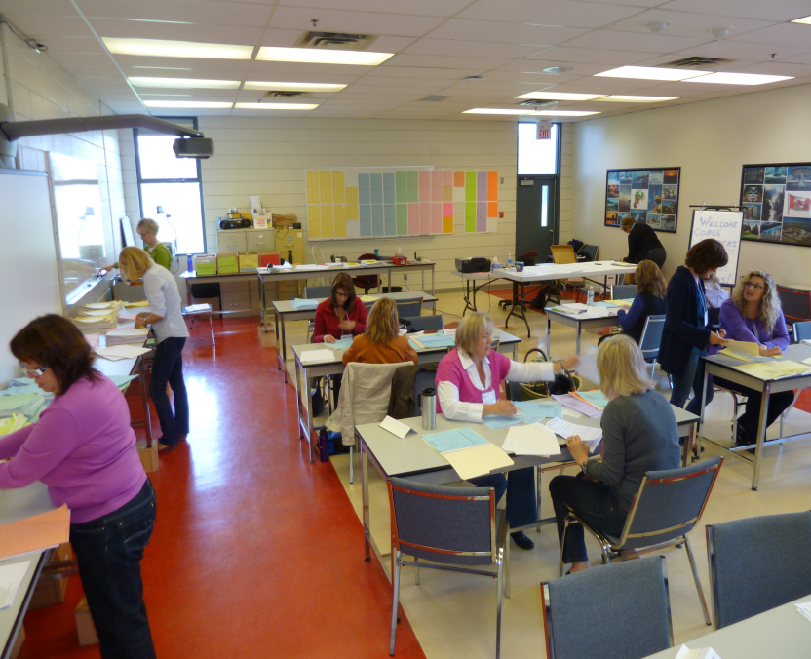
SELECTION PROCESS
Applications are submitted to school counsellors who then forward them to COBSS directly.
Applications are strictly confidential.
Applications are read only by school counsellors, donors and members of the COBSS selection committee consisting of representatives from each of the member schools.
School counsellors are not part of the selection process.
Notes:
Click to add notes

Slide 19
Selection is based on the following three areas:
Financial Need – based on line 150 of tax return and any special circumstances
Academic Ability – the average of student’s Grade 11 and Grade 12 marks
Active Citizenship – such as involvement in school and community

Slide 20
TYPES OF AWARDS
BURSARY – primarily based on financial need
SCHOLARSHIP – based on excellence; excellence can be in a variety of areas - academic, fine arts, applied skills, sports, community involvement, etc.
AWARD – based on donor discretion

Slide 21
ON-LINE APPLICATION
The on-line application is available at:
www.cobss.ca – and follow link:
If you are having difficulties, please see your school counsellor.
The on-line application opens on Nov. 29th .

Slide 22
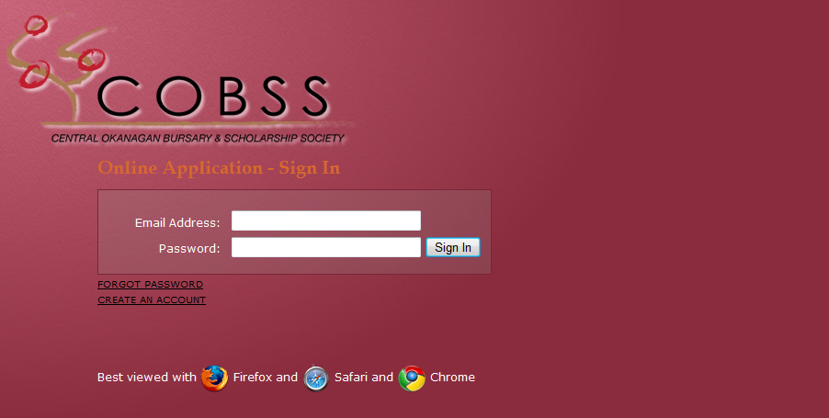
ON-LINE APPLICATION
Click on CREATE AN ACCOUNT

Slide 23
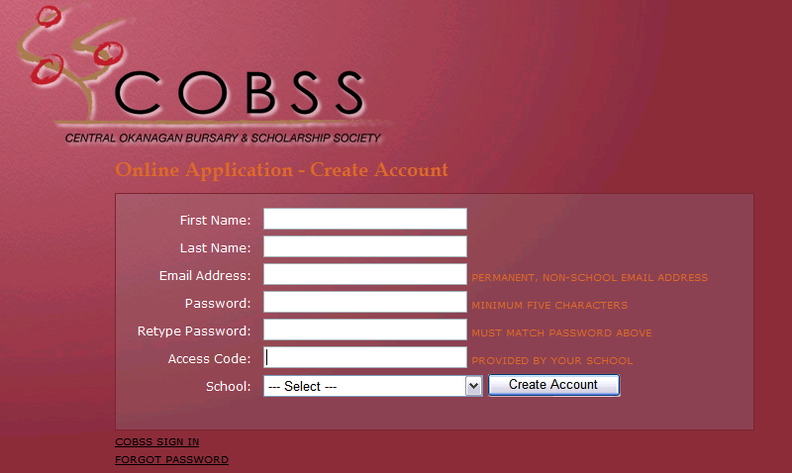

ON-LINE APPLICATION
OKM Access Code = okm2023
(lower case letters only)

Slide 24
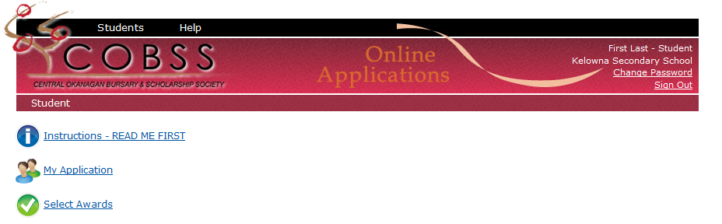
INSTRUCTIONS
Click on Instructions and follow carefully.
If you have any questions, please see your
school counsellor.

Slide 25
ON-LINE APPLICATION
There are three main components to the COBSS application package:
My Application section (largest part of application)
Select Awards section
Statement of Reference section
  forms to be filled out by two people.
  official COBSS form only – no additions

Slide 26
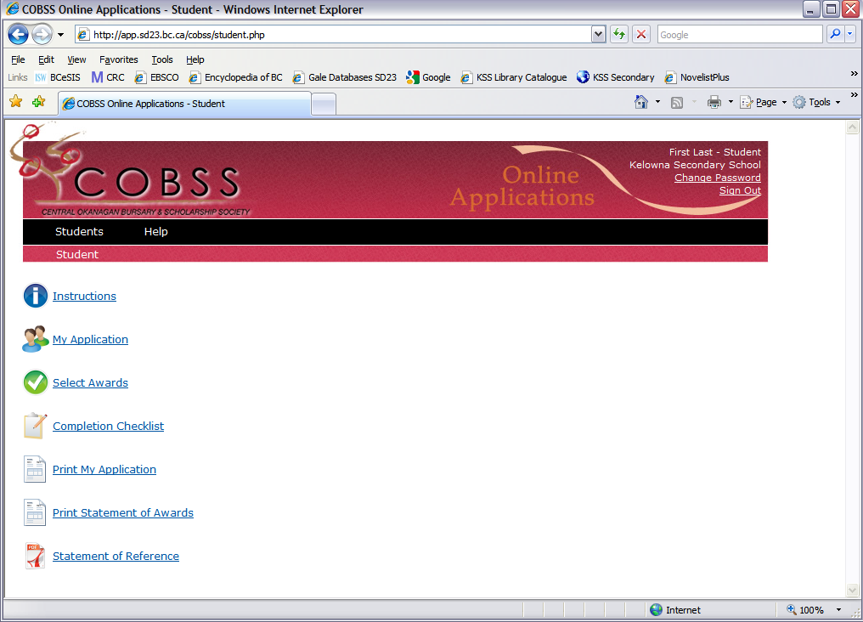
ON-LINE APPLICATION
Click on My Application to begin the
application process.

Slide 27
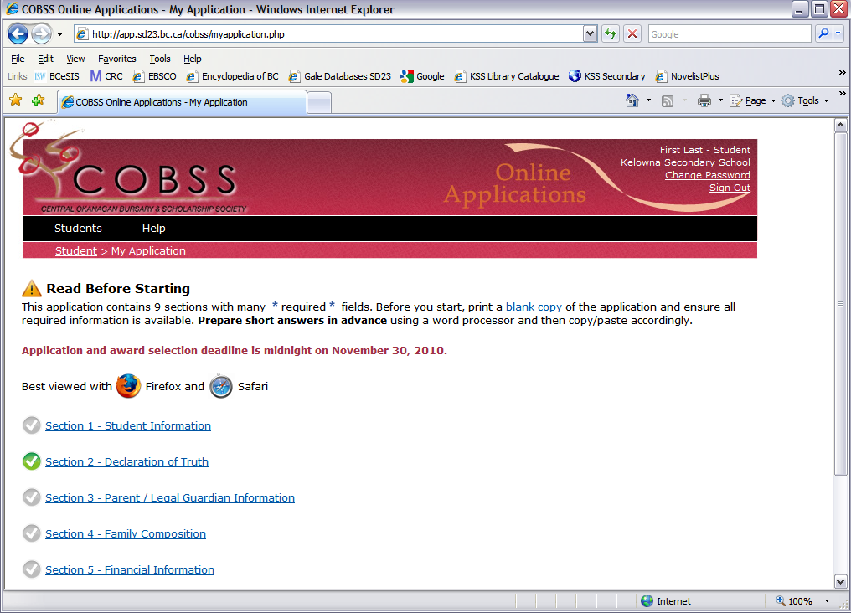
MY APPLICATION
There are nine sections to be completed.
When a section is completed, the check
mark will change from grey to green.

Slide 28
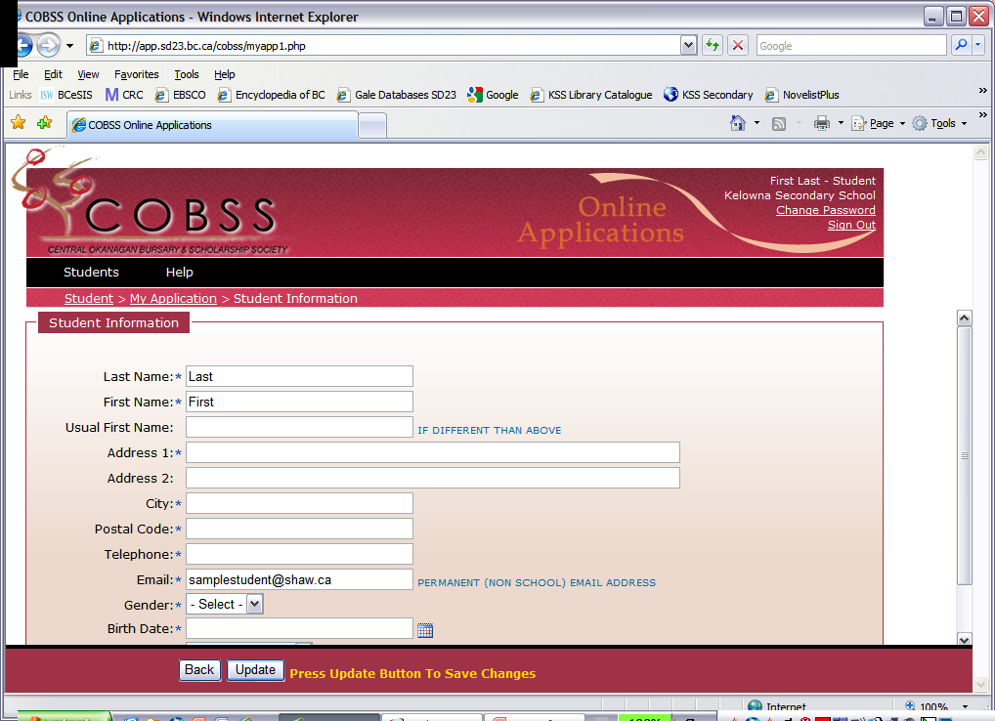

MY APPLICATION
Fill in the application form carefully and as
accurately as possible after reading all of the
instructions.
Students may go back and edit as often as they
wish until the site closes at 11:59 pm on Jan. 9th.

Slide 29
MY APPLICATION
Use the drop down menus where given.
Complete paragraph answers in the space provided.
Be aware that the secure site will time out.
TIP: Compose paragraphs in a Word Document, and
then cut and paste into COBSS application.
Space is limited so write concisely as there are a maximum number of characters available.
Please check spelling and grammar.

Slide 30
MY APPLICATION
One critical component of the application is the paragraph answers under Student Personal Statements.
There are 3 questions you will need to answer in this section.

Slide 31
MY APPLICATION
This is where your personality shows
through and helps the committee with
its decision.
BE CREATIVE, HONEST and CONCISE
and remember to proofread your answers.
With your words, you are trying to create a
vision in the donor’s mind of who you are,
what your goals and dreams are and why
you deserve to be selected for the award.

Slide 32
MY APPLICATION
QUESTION 1:
What are your educational/career plans? Describe the experiences that have contributed to these plans.
TIPS:
Try to be original and creative.
Do not start with “My name is____ and I am in grade 12 at ____.”

Slide 33
MY APPLICATION
QUESTION 2:
For the selection committee, describe the three qualities that best demonstrate your character. Use examples from your life to illustrate these qualities.
TIPS:
Try to get across who you are and what you are about in words.
You want to stand out in the sea of applications.

Slide 34
MY APPLICATION
QUESTION 3:
Describe your family (include custodial and non-custodial parent information). Explain any financial and non-financial struggles that you may have encountered.
TIPS:
Remember that financial need is one of the areas that selection is based on for COBSS awards.
This is a snapshot of your current family and financial situation.

Slide 35
MY APPLICATION
Another important part of the application is
Your Activity Details.
Students will include their activities from
grades 10, 11 & 12 in the following three areas:
Community & School Based Involvement & Achievements
Volunteer Experience
Paid Work Experience
No school credit courses!!

Slide 36
MY APPLICATION
Under each activity heading, list the
3 MOST SIGNIFICANT activities in which
you have been involved.
For each activity, list in this order:
Organization
Your activities/responsibilities/duties
Dates (mm/yyyy-mm/yyyy)
Estimated total activity hours (per week)
Total overall hours
TIP:
Remember to include anticipated hours until the end of June.

Slide 37
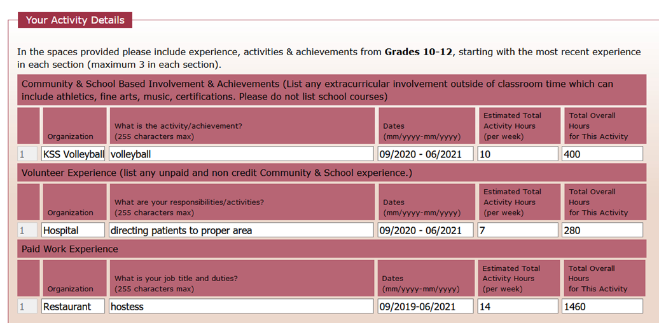
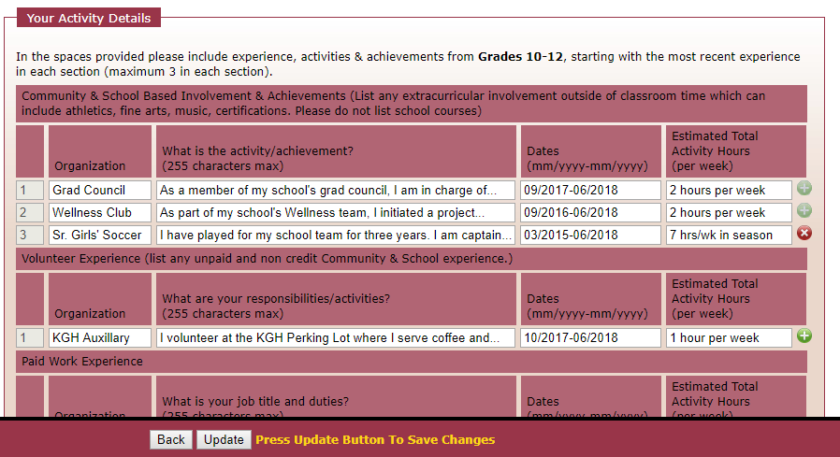
MY APPLICATION
Eg. of Community& School Based Involvement & Achievement:
Note: COBSS understands the pandemic has impacted students’ ability to be involved in the school & community. Include whatever you can.
!!!
Total Hours
Hours per week

Slide 38
MY APPLICATION
After completing Your Activity Details:
Choose one activity or achievement you have listed that you are most proud of
Explain what you have learned from it
TIPS:
You have 1000 characters to answer this question.
Remember that award selection is based on active citizenship so
this is a good place to expand on your involvement and include
reflective learning.
Note: COBSS understands the pandemic has impacted students’ ability to be involved in the school & community.

Slide 39
MY APPLICATION
When all sections of the application are completed, print one copy of My Application Form.
Student signature is required to confirm applicant meets all eligibility requirements and all information is accurate.
Parent or guardian signature is required to confirm that financial information is accurate.

Slide 40

MY APPLICATION
Print one copy of My Application
from icon on main page.

Slide 41
SELECT AWARDS
Click on Select Awards to view all awards available to your school. Please note that awards are subject to change.

Slide 42
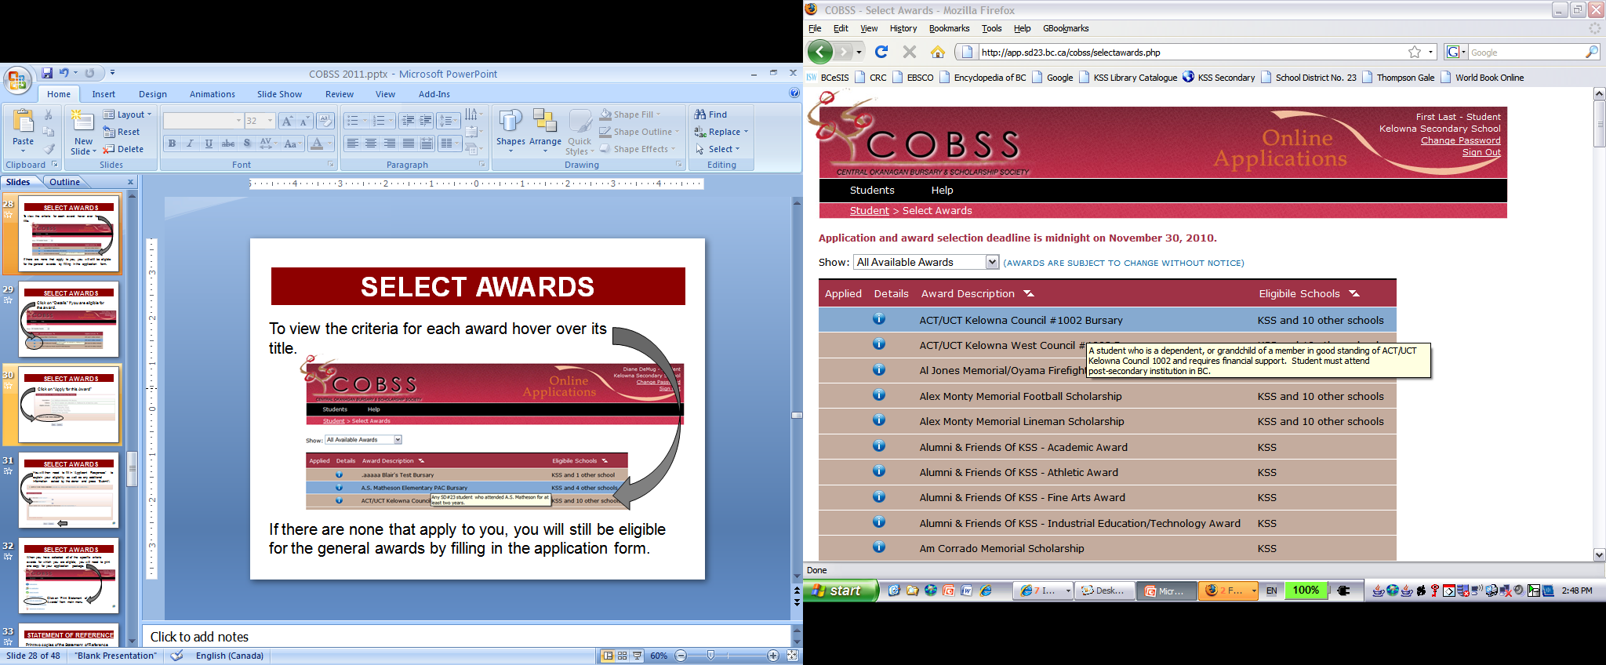
SELECT AWARDS
To view criteria for each award, hover over title.

Slide 43
SELECT AWARDS
Click on Details if eligible for award.

Slide 44
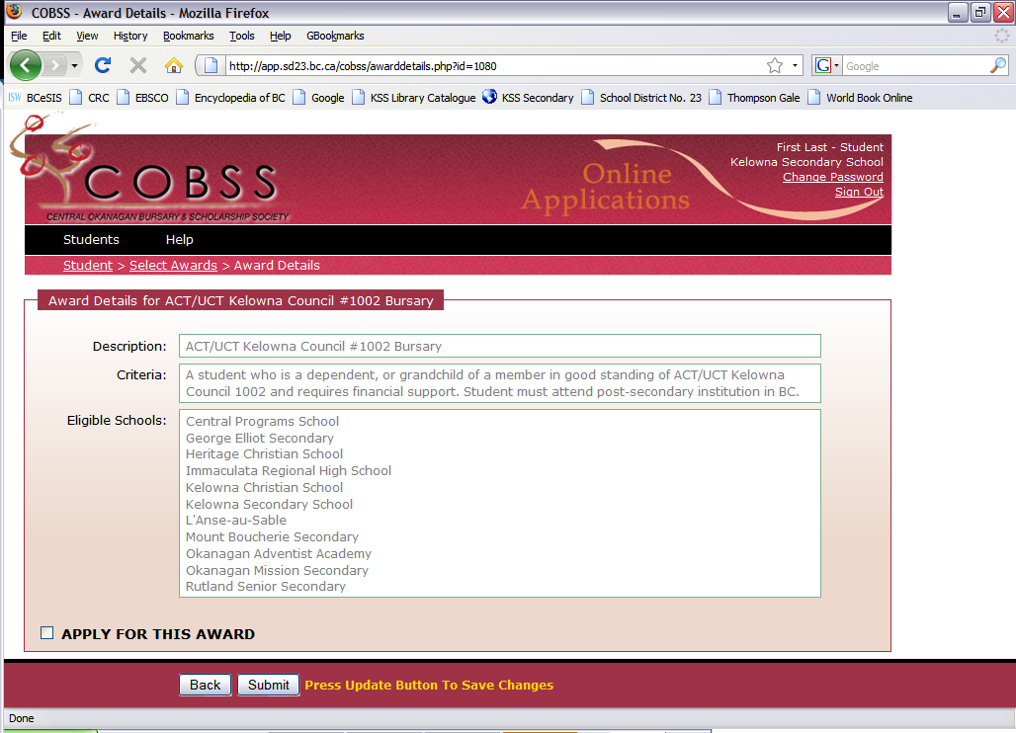
SELECT AWARDS
Click on APPLY FOR THIS AWARD

Slide 45
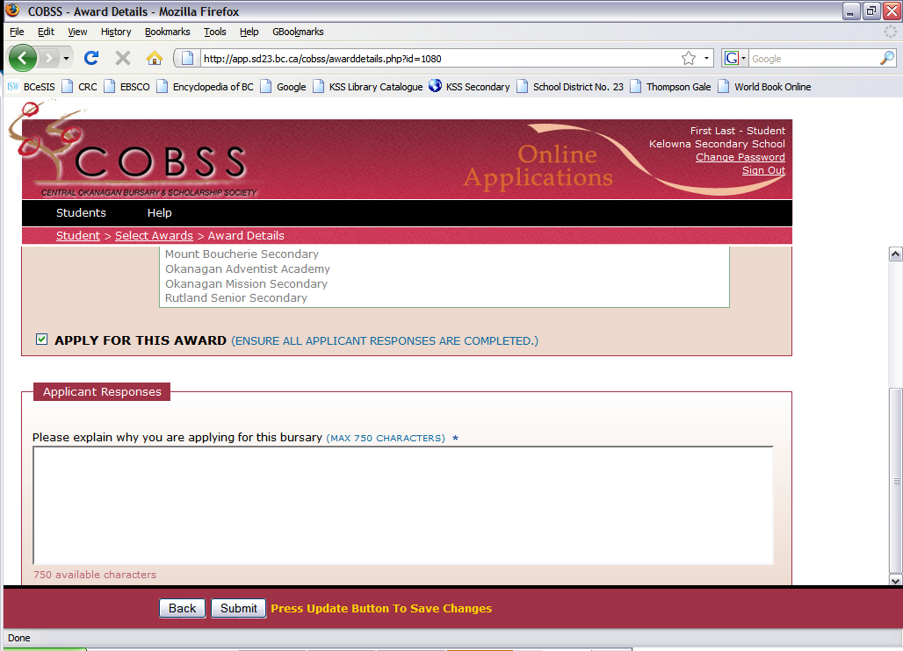
SELECT AWARDS
If prompted, fill in Applicant Responses to explain eligibility and additional information requested by the donor.
An Update button is at the bottom of each screen
to save information.

Slide 46
SELECT AWARDS
When all eligible awards are selected, print
one copy for application package.

Slide 47

STATEMENT OF REFERENCE
Print or email a copy of the Statement of Reference form and give to each referee ASAP.
TIPS:
Do this IMMEDIATELY to give your referees enough time to do a quality job!
Only the official COBSS reference page is accepted. No other documents!

Slide 48
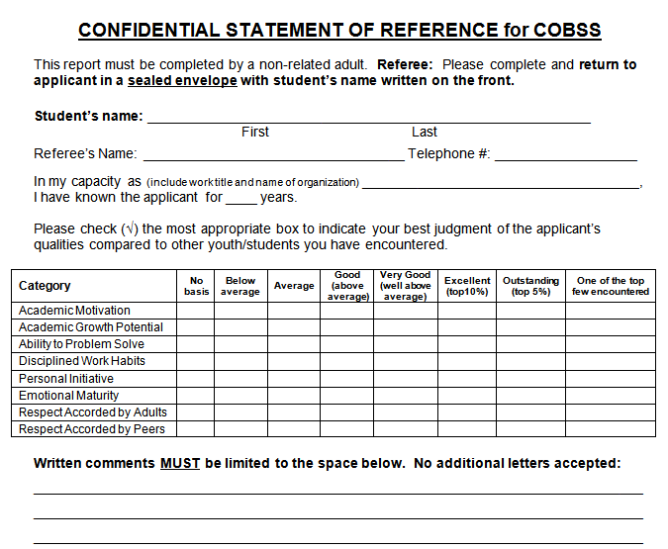
STATEMENT OF REFERENCE
Fillable PDF or paper copy → printed and signed to hand in
Fillable PDF on COBSS site (which can be emailed) OR print a paper copy and give to your referee.
EITHER WAY, completed reference form must be printed and signed as a paper copy is required for your application.

Slide 49
STATEMENT OF REFERENCE
Consider community people, employers, and
teachers as potential referees. (One teacher and one community reference is recommended.)
Choose referees carefully.
Print or email two copies before beginning
application to give referees ample time to complete.
Written comments must be contained to the front of form – no additional sheets accepted.
Statement of Reference Forms are confidential
and must be sealed in an envelope by your
referees OR referees may hand in the forms
directly to your school counsellor.

Slide 50
COMPLETION CHECKLIST
    When you have finished all instructions, click on Completion Checklist to ensure you have completed and printed all necessary documents.

Slide 51
ORDER OF DOCUMENTS
You will be handing in ONE completed COBSS
application package to your school counsellor.
The order for each is as follows:
1. One printout of My Application
2. One printout of the Statement of Awards
3. Two Statement of Reference forms (in sealed envelopes or handed in directly to school counsellor by referee)
Transcript – will be added by your school counsellor

Slide 52
OTHER
PAPER CLIP application package together. NO STAPLES!
Hand your application in person to the Counselling Centre. Do not pass it along through your friends.
Applications must be submitted on time.
Late applications will not be accepted

Slide 53
DUE DATE
The COBSS paper application package is due on or before:
Tues. Jan. 10th at 9:00 am
Plan your time accordingly
Remember that the online application form closes at 11:59 pm on Jan 9th and you cannot make changes or print after this time.

Slide 54
PLEASE REMEMBER
If you are a COBSS award recipient, please:
Write an immediate thank you note to your donor.
A follow up thank you note in the early fall is always a kind gesture.
TIP:
Keep a binder of all your awards so that you can track them accurately and use them before they expire.

Slide 55

Question:
When should I begin my COBSS application?
Answer:
It is recommended to begin the application as soon as possible. It is a lengthy process which takes a number of separate sittings to complete. It cannot be completed in one sitting.

Slide 56
Question:
When will I know if I have received a COBSS award?
Answer:
Awards are presented to individual student recipients at the school graduation ceremony.

Slide 57
Question:
Will my COBSS award expire?
Answer:
Yes, COBSS awards presented this year are valid until December 1st of your graduation year.

Slide 58
Question:
Can I take a year off for an exchange, a gap year, missionary work, etc. and still use my COBSS award?
Answer:
No, COBSS awards given out this year are valid until December 1st of your graduation year.

Slide 59

Question:
How do I know if the school I plan to attend is accredited as required for my COBSS eligibility.
Answer:
On the COBSS website is this link to search accredited institutions.

Slide 60
FAQ’s
Question:
What do I do with a COBSS award?
Answer:
A COBSS award recipient receives a voucher called a Certificate of Award (COA). To redeem the award at the post secondary school, a student can do one of the following:
1. Take the COA to the registrar of the post secondary to be validated and sent by the post secondary school to COBSS for payment.

Slide 61
FAQ’s
Answer (con’t):
2. If the registrar of the post secondary school will not send the validated COA to COBBS, then the student must return the validated COA via:
mail
scan and email OR
drop off at the COBSS office

Slide 62
FAQ’s
Answer (con’t):
3. If the registrar will not validate the COA, the
student needs to return two forms to COBSS:
the COA and
a Verification of Enrolment form from
the post secondary school

Slide 63
AWARD RECIPIENTS
If your circumstances change after you have received a COBSS award and you are no longer able to use the award before the December 1st deadline, please contact COBSS at cobss@shaw.ca.
The award money can then be given to an alternate recipient.

Slide 64
AWARD RECIPIENTS
If you have any questions regarding an award that you have received, please address all inquiries to COBSS directly at cobss@shaw.ca and not the award donor.

Slide 65
WHAT TO DO NEXT?
Research to find applicable opportunities:
- OKM Counselling website (Scholarships & Awards page)
- REMIND
- funding websites (independent research)
- potential post-secondary institutions’ funding sites
  Note applicable opportunities and follow up with applications
  Be organized with a calendar to track due dates and deadlines
  Independently complete applications (perhaps with family &/or friends as proof-readers ☺)

Slide 66
UPCOMING DATES:
Nov. 30th COBSS applications open
Dec. 1st UBC application deadline for awards and early admissions
Jan. 3rd OKM classes resume after winter break
Jan. 9th COBSS APPLICATION CLOSES @ 11:59pm
Jan. 10th Paper copy of COBSS application due to Counsellors by 9am
Jan. 15th UBC application general deadline
Jan. 27th Semester Turn Around (no classes)
Jan. 30th Semester 2 starts
March 10th OC Entrance Award Applications due

Slide 67

GOOD LUCK ON YOUR APPLICATIONS!
REMEMBER TO THOROUGHLY & CAREFULLY READ THROUGH THE COBSS INSTRUCTIONS!
Afterwards, if you need help or further information,
please see your counsellor:
Ms. Mackereth Ms. Dishaw
(A - K) (L - Z)

Slide 68
This presentation will be posted on the OKM Counselling Website:
http://okmcounselling.weebly.com/, Click on GRADS, and Scholarship/Awards

