Slide 1
Post Secondary Prep Session #3
Post-Secondary Planning File - getting organized!
Student Transcript Service
Online courses
Review: Sources of Funding
A year of post-secondary
What is a post-secondary ACADEMIC CALENDAR?
How to read COURSE INFO in Post-Sec Academic Calendar
Okanagan College: Updates, deposits, course planning, student supports
UBC: Updates, deposits, course planning, student supports
Residence Living: what to pack & tips for living on campus

Slide 2
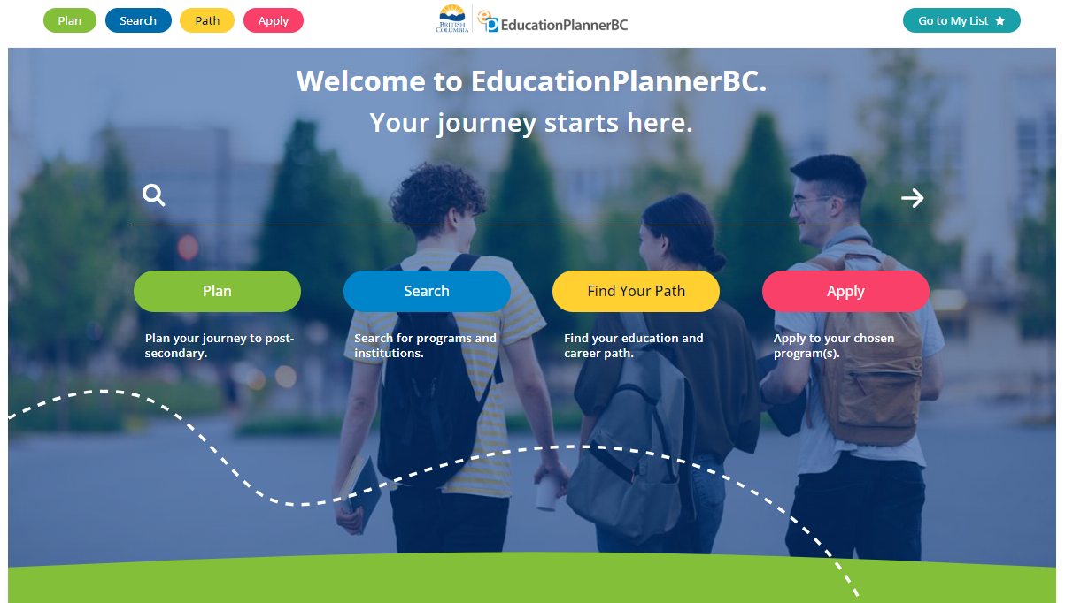
Post-Secondary Information
The EducationPlannerBC site is fantastic for searching programs, planning your education, & even applying! educationplannerbc.ca

Slide 3
Post-Secondary Information
The Post-Secondary BC site supports students & parents with information to make the best post-secondary decisions. Search programs, check for updates, & find events from almost all public B.C. Post Secondary Institutions. https://www.postsecondarybc.ca/

Slide 4
Post Secondary Planning File
Research, Brochures, calendars, pamphlets, emails, etc.
PSP #1 & #2 slides/notes
PEN number
Print outs of critical emails (acceptance, student numbers, etc)
LOGIN DETAILS:
StudentTranscripts Service login & password
Student numbers for each institution
Campus Login usernames & passwords for campus accounts of each institution
KEEP CAREFUL TRACK OF DEADLINES!
MAKE SURE YOU ARE ORGANIZED!

Slide 5
StudentTranscript Service
www.StudentTranscripts.gov.bc.ca
Must have your PEN # to create your account & complete your PSI choices (& to check your transcript)!
Identify that you would like interim and final marks sent to selected PSI’s when they become available
This allows the post secondary school to receive your marks electronically
ALL students planning to attend Post –Secondary should do this ASAP
This is the same site/account where students access transcripts, verify grades, and later view Ministry scholarships if awarded.

Slide 6
Marks Matter ALL YEAR LONG
Marks are transferred from the Ministry of Education electronically to post-secondary institutions in May and July.
It is IMPERATIVE that your grades are meeting the admission standards as set by the college/university.
Admission offers CAN BE RESCINDED if marks drop below the admission standards of the school
WORK HARD RIGHT TO THE END OF THE YEAR!

Slide 7
WARNING: ONLINE COURSES
As a guideline…. grade 12 students taking an online course required for graduation should be 90% complete by mid-May. This will position students to be fully complete by the end of the school year.
Please note: Eschool courses must be completed by June 14th or earlier.
If you are taking an online course for post-secondary entrance, remember that your PSI may require you to complete the course sooner than the online school requires. This may delay or cancel your offer of admission.

Slide 8
Have you planned your budget?
Remember, you will have to pay for:
Registration Deposits ($250 or more)
Housing Application fees & deposits ($50 - $500+)
Books & Supplies
Technology (if required)
ALL BEFORE SEPTEMBER!
…and first semester tuition is typically due the first week of September!

Slide 9
Review of Funding Sources
General Sources | OKM Counselling → Grads → Scholarships/Awards
 | studentscholarships.org
 | scholarshipscanada.com
 | studentawards.com
Specific Sources | BC Ministry of Education Scholarships (*District Authority)
 | COBSS (handed out at ceremonies in June)
 | Institution specific funding
Public Sources | Community opportunities
 | Student loans studentaidbc.ca (*available in June)
 | Student Lines of Credit
 | Parent/Relative affiliations through work/organizations (ie: Costco)

Slide 10
Lines of Credit vs. Student Loans
 | Student Line of Credit ARRANGE AT A BANK | Student Loan studentaidbc.ca (& your PSI)
possible Pros
possible Cons
Low interest rates customized for students
Interest only payments while in school and during grace period
You only owe what you spend
Boosts your credit score if payments made on time
Possible to get more money than with a student loan
Don’t have to make payments until after 6 month grace period
Don’t need a co-signer
Repayment assistance plan possibilities
Amount loaned largely based on financial need
May need a co-signer (parents?)
Have to make interest payments while in school
Parents’ income affects loan amount
Have to repay entire loan amount and provincial interest (*no interest charged for federal student loan)

Slide 11
Accredited Institutions
If you are using COBSS bursaries, student loans, or a provincial scholarship to pay for your tuition, you must be attending an accredited institution
Most public post-secondary institutions are accredited.
Use this button on the COBSS homepage to check your institution.

Slide 12
Is Your PSI Accredited?
To check if your institution is accredited go to:
Canada
https://www.canada.ca/en/employment-social-development/programs/post-secondary/designated-schools.html
US
http://www.cra-arc.gc.ca/chrts-gvng/qlfd-dns/qd-lstngs/prscrbdnvrsts-lst-eng.html
Non University
http://www.privatetraininginstitutions.gov.bc.ca/students/pti-directory

Slide 13
A Year at Post-Secondary The FALL Semester
Semester 1: Sept. – Dec.
Course 1 | 3 credits
Course 2 | 3 credits
Course 3 | 3 credits
Course 4 | 3 credits
Course 5 | 3 credits
* a student may have additional scheduled time for labs, tutorials, etc. during both or either semester
TOTAL UNITS of Semester 1 | 15 credits

Slide 14
A Year at Post-Secondary The WINTER Semester
Semester 2: Jan. – April
Course 1 | 3 credits
Course 2 | 3 credits
Course 3 | 3 credits
Course 4 | 3 credits
Course 5 | 3 credits
* a student may have additional scheduled time for labs, tutorials, etc. during both or either semester
TOTAL UNITS of Semester 2 | 15 credits

Slide 15
A Year at Post-Secondary The SPRING/SUMMER Semester
May - August
* Spring & Summer courses are possible, but usually limited offerings. * College & university campuses are pretty quiet with reduced office hours and campus services. * Most students get a job to pay for the next academic year!

Slide 16
A Year at Post-Secondary
Semester 1: Sept. – Dec. |  | Semester 2: Jan. - April |  | May - August
Course 1 | 3 credits | Course 1 | 3 credits | * Spring & Summer courses are possible, but usually limited offerings. * Campuses are quite quiet * Most students get a job to pay for the next academic year!
Course 2 | 3 credits | Course 2 | 3 credits
Course 3 | 3 credits | Course 3 | 3 credits
Course 4 | 3 credits | Course 4 | 3 credits
Course 5 | 3 credits | Course 5 | 3 credits
* a student may have additional scheduled time for labs, tutorials, etc. during both or either semester
TOTAL UNITS of Semester 1 | 15 credits | TOTAL UNITS of Semester 2 | 15 credits
TOTAL UNITS from a full time year at post-secondary |  |  |  | 30 credits
TOTAL UNITS for a Bachelor of Arts or Bachelor of Science DEGREE (4 years x 30 units / year) |  |  |  | 120 credits

Slide 17
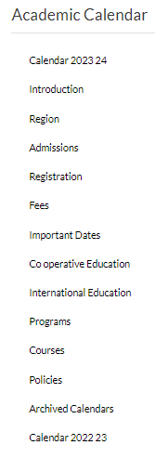
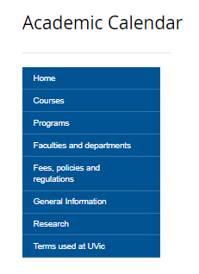
What is a Post-Secondary ACADEMIC CALENDAR ?
OC UVIC UBCO
The school’s “RULE BOOK”
A post-secondary institution’s published rules, regulations, academic policies, important dates, programs (& their requirements), and courses.

Slide 18
How to Read COURSE INFORMATION in the Post-Secondary Academic Calendar
Search “academic calendar”on your PSI’s site.
Look for “courses” / “course info” / “course descriptions”.
Subject
Course Number
Credit
Discussion or Tutorial
(hours per week)
Lecture (hours per week)
Lab
(hours per week)
Must successfully complete before enrolling in this course
Must be registered in while taking the course or successfully completed before enrolling in this course

Slide 19
Okanagan College
https://www.okanagan.bc.ca/

Slide 20
OC: Admissions
Applications are still open to many programs
Most programs available until all seats are filled (exception are LPN and Dental Assisting)
Even if you do not have all of the entrance requirements fulfilled, contact OC admissions for options at 250-762-5445 or https://www.okanagan.bc.ca/education-advising#admissions

Slide 21
OC: Admissions
Once you receive your letter acknowledging your application, ensure you complete all tasks required, such as:
-proof of enrolment in English 12, transcript sent, etc.
Important dates/deadlines vary, so please check your correspondence in your myOkanagan account carefully.
Pay your deposit to secure your seat 🡪 deposit amounts vary by program. Check website for details.
Ex: Health/Tech/Trades: $200 (+ $200 more approx. 90 days before start of program)
All others: $200
Choose and plan out your courses prior to your course registration date
You will be given a registration package which will outline the process

Slide 22
OC: SCHEDULES
Once you are accepted, log into your “myOkanagan” account. This will be your guide for courses, creating schedules, finances, etc. Check regularly!
Students choose courses and create schedules for Associate of Arts, Associate of Science, & Business only.
All other programs have set schedules.
Log in to “myOkanagan” to see set schedules.
Need help planning courses? (scroll down to “Plan your courses”) https://www.okanagan.bc.ca/education-advising#planning
PLAN AHEAD IF YOU WANT TO SEE AN EDUCATION ADVISOR ABOUT COURSES.

Slide 23
OC: SCHEDULES
Course times will be posted in Classfinder in your “myOkanagan” account mid June so students can pre-plan their schedules. Create more than one possible schedule.
Be sure to look at courses for prerequisites. You may register for any class so make sure you have the required prerequisite course(s). It is on you.
Need help? Access registration video on “MyOkanagan” account under “Course registration help”

Slide 24
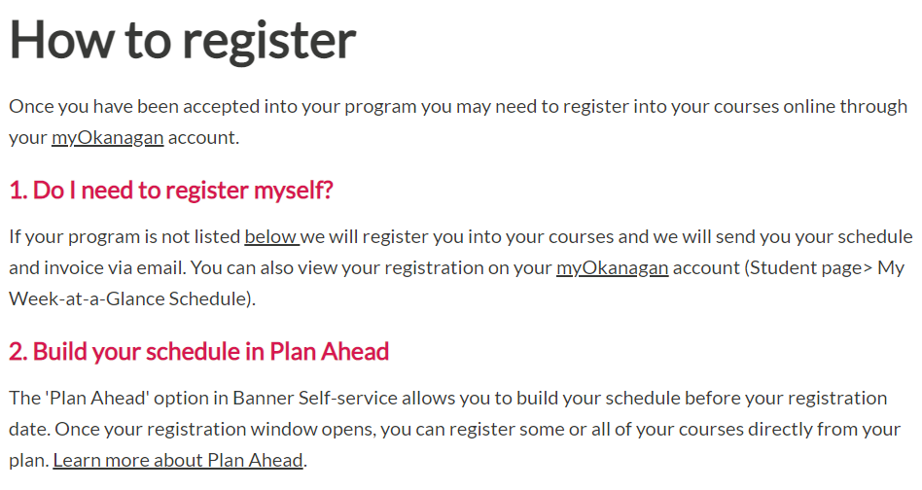
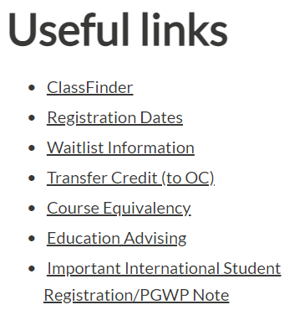
Okanagan College Registering for your courses
https://www.okanagan.bc.ca/office-of-the-registrar/how-to-register
ALL campuses: 1st year students register early July

Slide 25
Okanagan College Advisors
NINA CASANO
Recruitment and Events Coordinator
250-762-5445 ext 4161
ncasano@okanagan.bc.ca
AskOC@okanagan.bc.ca
Michelle Somerville
Education Advisor
250-862-5656
msomerville@okanagan.bc.ca
AskOC@okanagan.bc.ca
Vivian Moretti
Education Advisor
250-862-5656
vmoretti@okanagan.bc.ca
AskOC@okanagan.bc.ca
Questions about OC?
Need help planning your program?
AskOC@okanagan.bc.ca

Slide 26
OC: Student Support
“ACCESSIBILITY SERVICES”
Mental Health conditions- Anxiety/Depression
Learning Disabilities- Dyslexia/ Dysgraphia
Neurological Disabilities- ADHD/Autism Spectrum
Physical Disabilities/ Hearing / Vision
PLAN AHEAD!! Connect with these services PRIOR to the start of your program so they can PROACTIVELY support you!

Slide 27
OC: Student Support
Can provide separate setting, supports
All services confidential
Call for information 250-862-5451.
Samantha Matychuk
Accessibility Services Coodinator smatychuk@Okanagan.bc.
250-762-5445 ext 4477

Slide 28
UBC
https://you.ubc.ca/

Slide 29
UBC: Admissions
First round offers complete.
Students who did not receive a first round offer will now be considered. Offers out by mid/end of April.
Receive decision or waitlisted depending on program
Accept offers by either May 1st or June 1st and pay your $500 acceptance deposit to UBC with credit card or online banking
All offers are conditional – you must maintain grades to ensure acceptance
Course information and registration occurs in June.
You will be given specific date for your course registration
https://you.ubc.ca/applying-ubc/blog/
Plan ahead. Contact UBC advisors with any questions.

Slide 30
UBC: Admissions
Accepted to UBC OKANAGAN:
Contact Student Services on the Okanagan Campus for assistance with next steps, such as course registration, course planning and finances.
https://students.ok.ubc.ca/academic-success/academic-advising/
Accepted to UBC VANCOUVER:
Students who have been admitted and accepted their offer will be assigned an Enrolment Services Advisors (ESA) https://students.ubc.ca/about-student-services/enrolment-services-advisors to help with financial, academic & health resources. Students can expect an email from their ESA.

Slide 31
UBC: Navigating your Degree
DEGREE NAVIGATOR:
View program requirements & plan your degree
View course information as outlined in UBC Academic Calendar
Access: Log into the Student Service Centre (SSC) and click on “Degree Navigator” under “Registration”. You must have accepted an offer to access.
*** Tutorials available along with Degree Navigator Tip Sheet at: https://students.ok.ubc.ca/academic-success/degree-planning/
FIRST YEAR ADVISING GUIDES:
https://students.ok.ubc.ca/academic-success/degree-planning/
Choose your program and the advising guides will outline first year required and elective courses and options.
Notes:
31

Slide 32
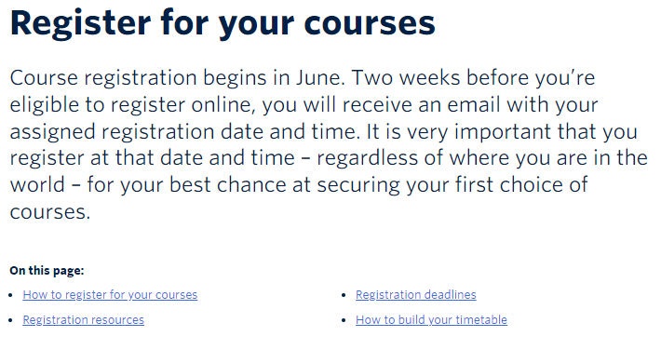
UBC Registering for your courses
https://you.ubc.ca/applying-ubc/admitted/register/
Okanagan campus: 1st year students register June 24th & 26th
Vancouver campus: 1st year students register (to be announced)

Slide 33
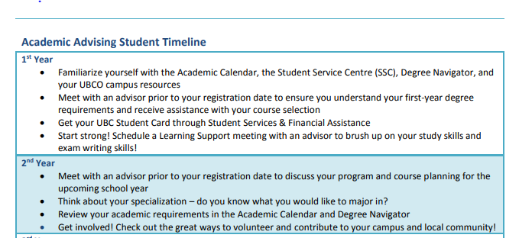
UBC Advising Timeline
ACADEMIC ADVISING INFO:
https://students.cms.ok.ubc.ca/wp-content/uploads/sites/90/2019/07/Academic-Advising-Syllabus.pdf

Slide 34
UBC: Campus Tours
Visiting UBC in person or with a live virtual campus tour is the best way to experience life at a global top 40 university.
A tour will help you get a feel for UBC. You will visit academic, social, and recreational facilities, and ask questions galore!
Virtual Indigenous campus tours also available (Vancouver)
https://you.ubc.ca/tours-events/campus-tours/

Slide 35
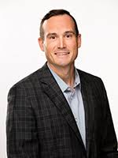
UBC Advisors
Contact UBC Advisor for any other questions
UBC: Anthony Dodds
250-807-9269
anthony.dodds@ubc.ca
UBC: Lauren Schroeder
250-807-9159
lauren.schroeder@ubc.ca
UBC/ UBC-O General inquiries: recruitment.ok@ubc.ca, 250-807-8521. Voicemails are returned within 24hrs, emails usually 3-5 days.

Slide 36
UBC STUDENT SUPPORT
Supports for all types of challenges:
Mental Health (Anxiety, Depression, etc)
Learning disabilities
Neurological disabilities (ADHD, Autism, etc)
Physical Disabilities (Hearing, Vision, etc.)
PLAN AHEAD!! Connect with these services PRIOR to the start of your program so they can PROACTIVELY support you!

Slide 37
UBC STUDENT SUPPORT
VANCOUVER: “Centre for Accessibility” https://students.ubc.ca/about-student-services/centre-for-accessibility
604-822-5844
info.accessibility@ubc.ca
OKANAGAN: “Disability Resources”
https://students.ok.ubc.ca/academic-success/disability-resources/
250-807-8053
drc.questions@ubc.ca

Slide 38
Questions? Concerns? Special Circumstances?
CONTACT YOUR INSTITUTION!
The advisors are there to help you!
TALK TO THEM!

Slide 39
Things to Do
Ensure that the university/college has been added to your email “safe list” so messages don’t end up in your junk mail
Check email, student account, & mail frequently as they will be sending you important info about events, upcoming dates, etc.
Make notes on your calendar about important dates such as self-reporting, registration, welcome day, etc.
Visit the website (campus student login), plan out your courses, & create multiple schedules so you are ready for your registration date. Make an appointment to see an advisor if necessary.
Have your courses chosen BEFORE your given registration date

Slide 40
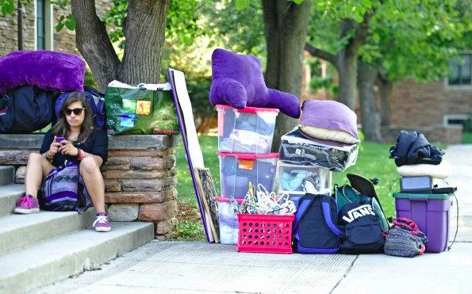
Residence Living
Apply for housing & pay your deposits
Confirm dates & deadlines for residence move in days and times
WHAT TO BRING: Your post-sec site will have a list of supplies to bring.
UVIC: https://www.uvic.ca/residence/future-residents/moving-in/index.php
UBCV: https://vancouver.housing.ubc.ca/moving-in/what-should-i-pack/
University of Calgary: https://www.ucalgary.ca/ancillary/residence/move-in/what-to-bring
Western: https://residence.uwo.ca/resources/movein_planning_guide
U of Toronto: https://www.utsc.utoronto.ca/residences/what-bring

Slide 41
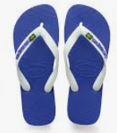
More Residence Tips
Foamy for your bed – a good night’s sleep is important
Mattress enclosure – it’s like a hotel mattress
Sheets – some res. beds are an odd size of twin XL and sheets are hard to find
Ear plugs – dorms can be a noisy environment
Set two alarms – especially during midterms and finals
Shower flip flops, a robe, and a shower caddy
Mini fridge (may want to buy early as they sell out in September)
Sticky tack for putting things on your walls – you want your deposit back
Some personal items – add some sense of home/personality
Skinny hangers/drawer separators – not a lot of storage space
Good lighting for your desk/room if not provided
Stock up on cold meds, tissues, rapid COVID tests, etc. – you will get sick!
Coins, tokens, laundry card depending on the residence building
Laundry detergent, disinfectant wipes
Calendar/planner – YOU are accountable and each assignment/test is worth a lot
Trolley, large suitcases on wheels, heavy duty garbage bags for moving
DON’T LOSE YOUR ROOM KEY, MAIL KEY & STUDENT CARD (expensive to replace)

Slide 42
Additional Reminders:
OKANAGAN COLLEGE
Pay your deposit and verify important dates for your program.
Ensure you create your MyOkanagan account
UBC/UBC OKANAGAN
Accept the offer and pay your $500 acceptance deposit online before May 1 or June 1 (faculty dependent)
Apply by May 1st for housing to guarantee your 1st year housing
Residence confirmation comes in early June
Course registration opens in late June (have your course work lists ready to go)

Slide 43
Good Luck to Everyone!
We wish you the best as you embark on your post-secondary education!
As you hear from Post-Secondary Institutions, please stop by the Counselling Centre. We love to hear your happy news & celebrate with you!

